Slide 1

EEI4346 Web Technology Day School 03 + Practical Session 02
H.R.S.Senanayake
Email: hrsen@ou.ac.lk CITES Faculty of Engineering Technology The Open University of Sri Lanka

Slide 2

Content
Server-Side Programming
PHP
Frameworks
Department of……………………………

Slide 3

Server-Side Programming
A technique used in web development involves employing scripts on a web server that produces a response customized for each user's request to the website.
Department of……………………………

Slide 4

Programming Languages
PHP
C++
Java and JSP
Python
Ruby on Rails
Department of……………………………

Slide 5
PHP
Allows web developers to create dynamic content that interacts with databases
PHP is basically used for developing web-based software applications
Can be integrated with a number of popular databases, including MySQL, PostgreSQL, Oracle, Sybase, Informix, and Microsoft SQL Server.
Department of……………………………

Slide 6
PHP Syntax
PHP script starts with <?php and ends with ?>
File extension for PHP files is .php
PHP file normally contains HTML tags and some PHP scripting code
Keywords, classes, functions, and user-defined functions are not case-sensitive
All variable names are case-sensitive
Department of……………………………

Slide 7
PHP Comments
Purpose is to be read by someone who is looking at the code.
Mainly two types of comments:
Single Line Comments
// This is a single-line comment
# This is a single-line comment
Multiple Line Comments
/*
This is a
multiple-lines
comment */
Department of……………………………

Slide 8
PHP Variables
Used to store information to be referenced and manipulated in a computer program
Variable names are case-sensitive
PHP variable starts with the $ sign
<?php
$name = “Amali";
$value_01 = 5;
$value_02 = 10.5;
?>
Department of……………………………

Slide 9
Data Types
PHP Data Types :
String
Integer
Float (floating-point numbers - also called double)
Boolean
Array
Object
NULL
Resource
Department of……………………………

Slide 10
PHP String Function
strlen() - Return the Length of a String
str_word_count() - Count Words in a String
strrev() - Reverse a String
strpos() - Search For a Text Within a String
str_replace() - Replace Text Within a String
Department of……………………………

Slide 11
PHP Number Function
is_int() - Check if the type of a variable is int
is_float() - Check if the type of a variable is float
is_numeric() - Check if the variable is numeric
(int)$variable_name - Cast float to int
Department of……………………………

Slide 12
PHP Operations
Operator | Name | Example
+ | Addition | $x + $y
- | Subtraction | $x - $y
* | Multiplication | $x * $y
/ | Division | $x / $y
% | Modulus | $x % $y
** | Exponentiation | $x ** $y
Department of……………………………

Slide 13
PHP Operations
ment | Same as... | Description
x = y | x = y | The left operand gets set to the value of the expression on the right
x += y | x = x + y | Addition
x -= y | x = x - y | Subtraction
x *= y | x = x * y | Multiplication
x /= y | x = x / y | Division
x %= y | x = x % y | Modulus
Department of……………………………

Slide 14
Conditional Statements
if...else statement executes some code if a condition is true and another code if that condition is false
if (condition) { code to be executed if the condition is true; } else { code to be executed if the condition is false; }
Department of……………………………

Slide 15
PHP Loops
For Loop:-
for (init counter; test counter; increment counter)
{
code to be executed for each iteration;
}
While- Loop:-
while (condition is true)
{
code to be executed;
increment;
}
Do –While Loop:-
do { code to be executed;
increment; } while (condition is true);
Department of……………………………

Slide 16
PHP Function
A block of statements that can be used repeatedly in a program
Will not execute automatically when a page loads
Will be executed by a call to the function
function functionName()
{ code to be executed; }
Department of……………………………

Slide 17
PHP Array
A special variable, which can hold more than one value at a time
array() - function is used to create PHP array
count() - return the length (the number of elements) of an array
A multidimensional array is an array containing one or more arrays
Department of……………………………

Slide 18
PHP GET Method
The GET method is restricted to sending up to 1024 characters only.
Never use the GET method if you have a password or other sensitive information to be sent to the server.
GET can’t be used to send binary data, like images or word documents, to the server.
The data sent by GET method can be accessed using the QUERY_STRING environment variable.
The PHP provides a $_GET associative array to access all the sent information using the GET method.
Department of……………………………

Slide 19
PHP POST Method
The POST method does not have any restriction on the data size to be sent.
The POST method can be used to send ASCII as well as binary data.
The data sent by POST method goes through the HTTP header, so security depends on HTTP protocol. By using Secure HTTP, you can make sure that your information is secure.
The PHP provides a $_POST associative array to access all the sent information using the POST method.
Department of……………………………

Slide 20
Example GET/POST
<?php
echo "Welcome ". $_GET['name']. "<br />";
?>
<html>
<body>
<form action = "<?php $_PHP_SELF ?>" method = "GET">
Name: <input type = "text" name = "name" /> <input type = "submit" />
</form>
</body>
</html>
Department of……………………………

Slide 21
Frameworks
A platform for developing software applications
A software framework is built on top of a programming language
There are many types of software frameworks to make it easier for developing applications
Department of……………………………

Slide 22
Web Frameworks
Angular – A typescript-based, open-source JS framework that makes it easy to build applications on the web. Angular solves application development challenges by combining declarative templates, dependency injection, end-to-end tooling, and much more
Laravel - PHP-based web application framework with an expressive, elegant syntax. The open-source framework follows a model-view-controller design pattern that is robust and easy to understand.
CodeIgniter
Department of……………………………

Slide 23
CodeIgniter
An application development framework, which can be used to develop websites, using PHP
Has a very rich set of functionality, which will increase the speed of website development work
Model-View-Controller Based System
Full Featured database classes with support for several platforms
Department of……………………………

Slide 24
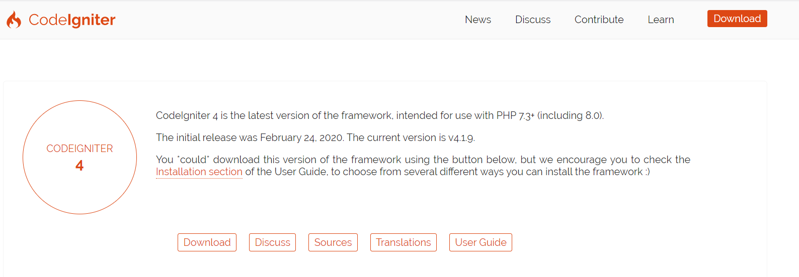
Install CodeIgniter
Step-1 − Download the CodeIgniter- http://codeigniter.com/download
3
Department of……………………………

Slide 25
Install CodeIgniter
Step-2 − Unzip the folder.
Step-3 − Upload all files and folders to your server.
Step-4 − After uploading all the files to your server, visit the URL of your server, e.g., www.domain-name.com.
Department of……………………………

Slide 26

Thank you
PO Box 21, Nawala, Nugegoda, Sri Lanka
Phone: +94 11 288 100
www.ou.ac.lk

